Slide 1
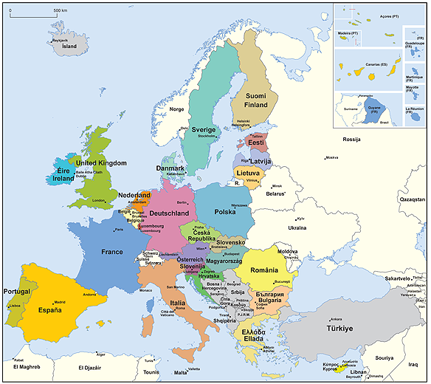

The European Union: 500 million people – 28 countries
Member States of the European Union
Candidate countries and potential candidates
Notes:
‹#›

Slide 2

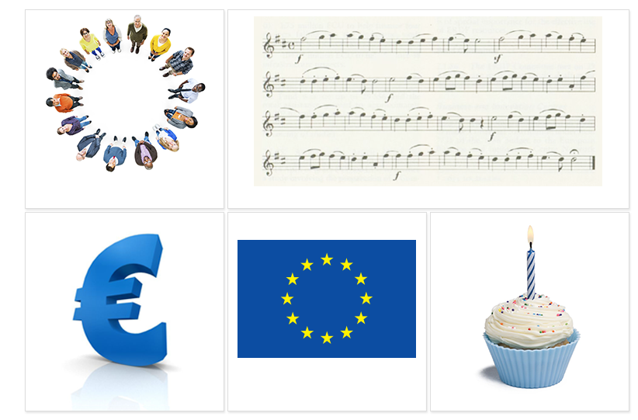
The EU symbols
The motto:
United in diversity
The European anthem
The euro
The European flag
Europe Day, 9 May

Slide 3
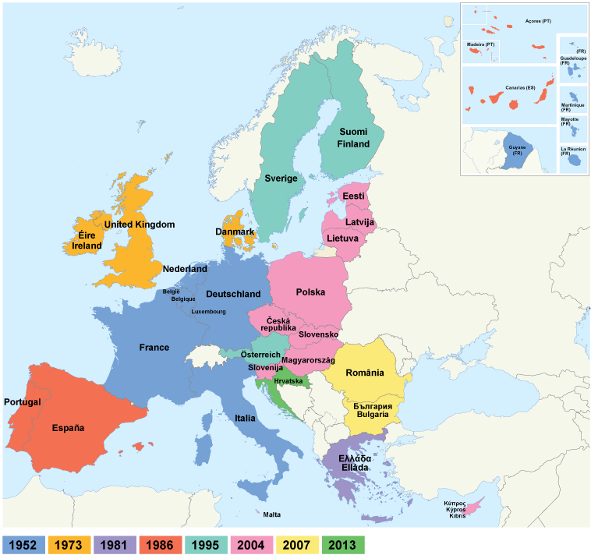
Enlargement: from six to 28 countries

Slide 4
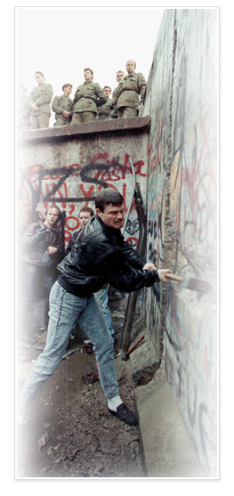
The big enlargement: uniting east and west
1989
Fall of Berlin Wall – end of Communism
EU economic help begins: Phare programme
1992
Criteria set for a country to join the EU:
• democracy and rule of law
• functioning market economy
• ability to implement EU laws
1998
Formal negotiations on enlargement begin
2002
Copenhagen summit agrees to a big enlargement of 10 new countries
2004
Ten new EU members: Cyprus, Czech Republic, Estonia, Hungary, Latvia, Lithuania, Malta, Poland, Slovakia, Slovenia
2007
Bulgaria and Romania join the EU
2013
Croatia joins on 1 July

Slide 5
Candidate countries and potential candidates
Country | Area (x 1000 km²) | Population (millions) | Wealth (gross domestic product per person)
Bosnia and Herzegovina | 51 | 3.8 | 7 600
Montenegro | 14 | 0.6 | 10 900
Iceland | 100 | 0.3 | 30 000
Kosovo under UN Security Resolution 1244 | 11 | 1.8 | :
The former Yugoslav Republic of Macedonia | 25 | 2.1 | 9 100
Albania | 28 | 2.9 | 7 500
Serbia | 77 | 7.2 | 9 100
Turkey | 783 | 76.7 | 13 800
The 28 EU countries together | 4 272 | 507.4 | 25 700

Slide 6

The treaties – basis for democratic cooperation built on law
1952
The European Coal and Steel Community
1958
The treaties of Rome:
• The European Economic Community
• The European Atomic Energy Community
(EURATOM)
1987
The European Single Act: the Single Market
1993
Treaty on European Union - Maastricht
1999
Treaty of Amsterdam
2003
Treaty of Nice
2009
Treaty of Lisbon
Notes:
‹#›

Slide 7
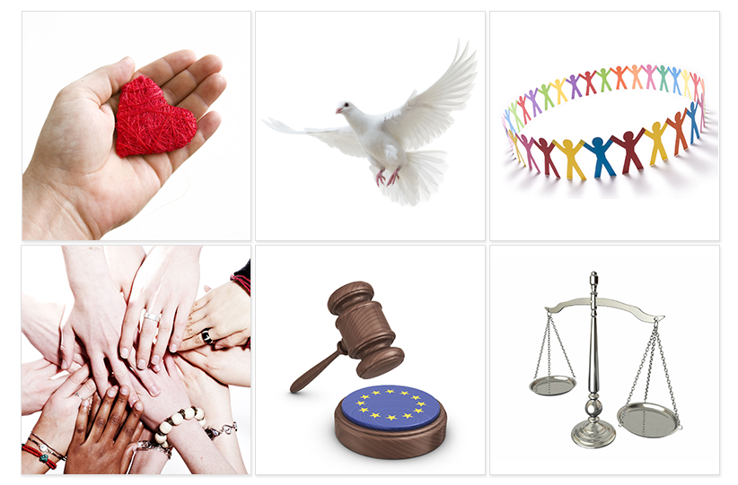
The EU Charter of Fundamental Rights
Binding for all the EU's activities
54 articles under 6 titles:
Dignity
Freedoms
Equality
Solidarity
Citizens’ rights
Justice

Slide 8
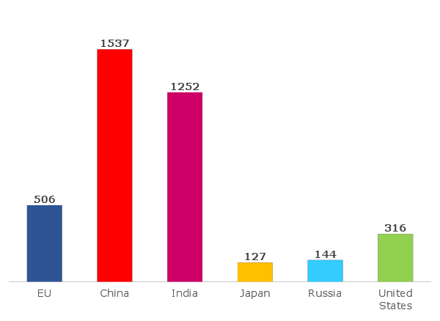
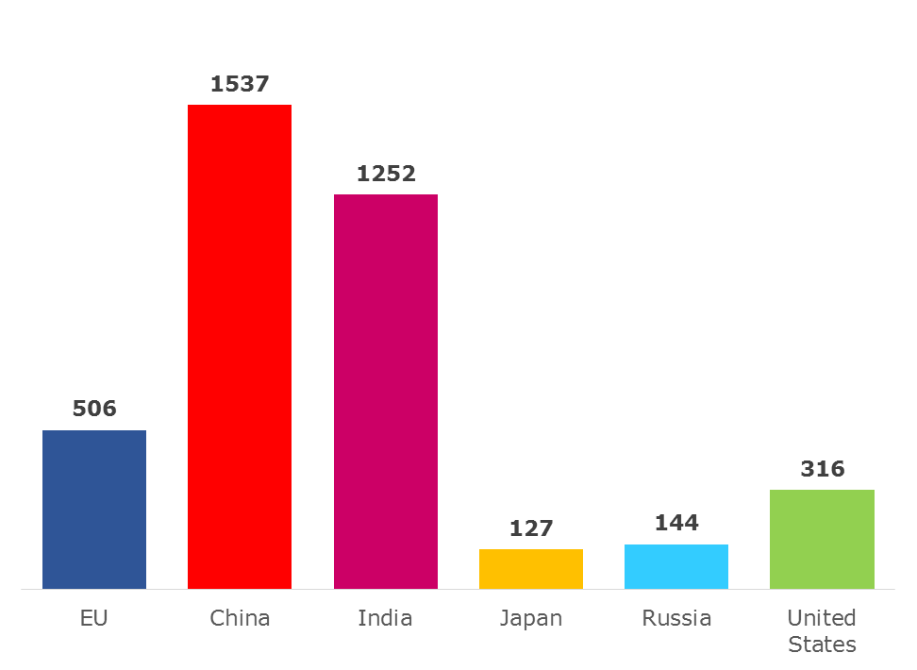
EU population compared to the rest of the world
Population in millions (2014)
Notes:
‹#›

Slide 9
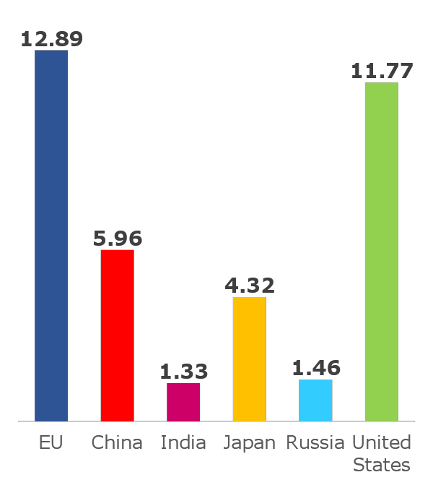
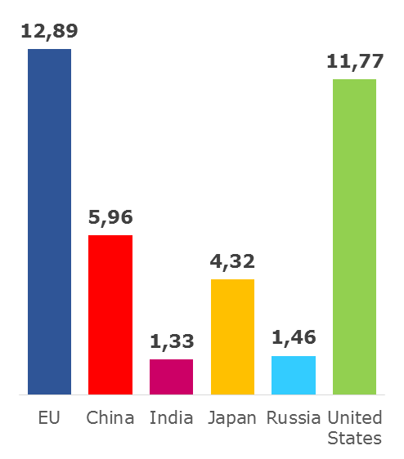
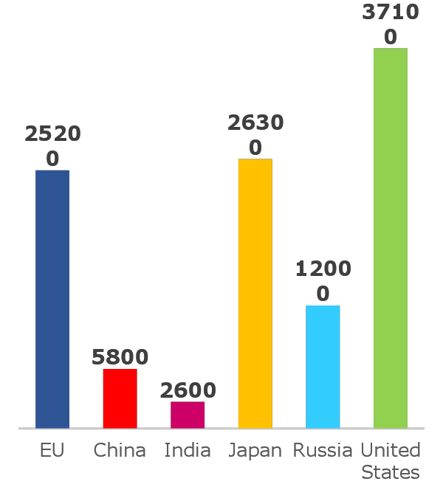
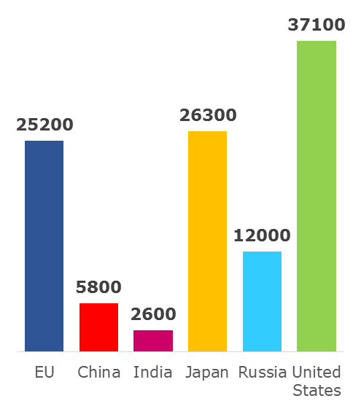
How rich is the EU compared to the rest of the world?
Size of economy:
GDP in trillions of euro (2012)
Wealth per person:
GDP per person (2012)

Slide 10
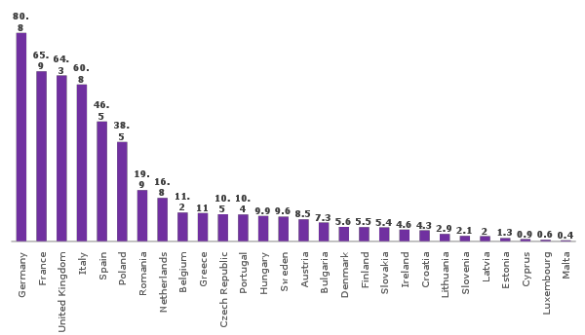
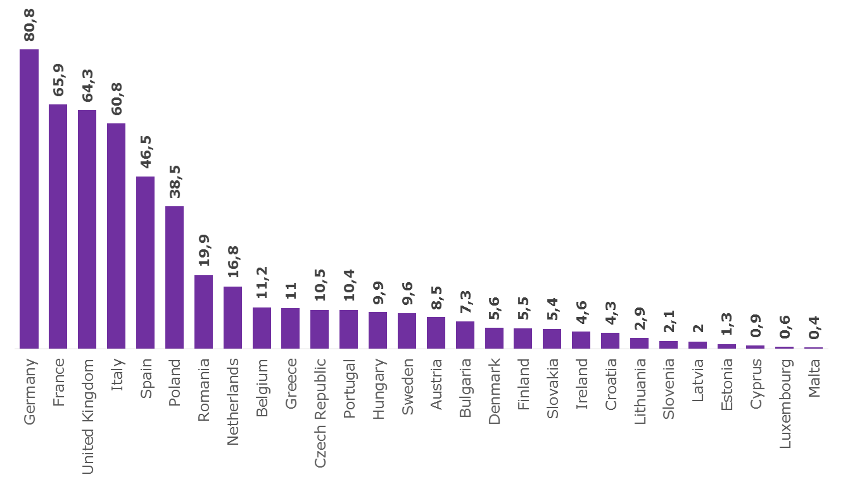
How many people live in the EU?
Population in millions (2014)
507 million in total
Notes:
‹#›

Slide 11
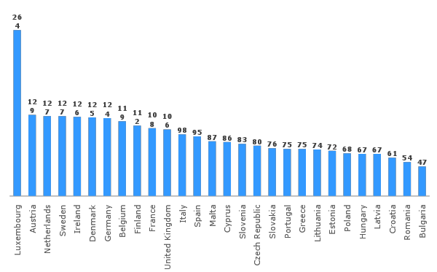
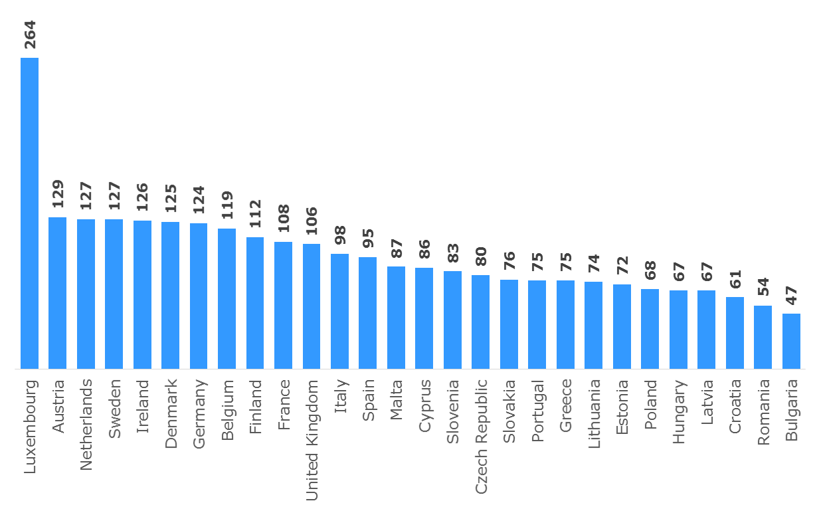
GDP per inhabitant: the spread of wealth
GDP per inhabitant (2013)
Index where the average of the 28 EU countries is 100
Notes:
‹#›

Slide 12
The five targets for the EU in 2020
Agreed in the Europe 2020 strategy:
Employment
75 % of 20 to 64-year-olds to be employed
Research and innovation
3 % of the EU's GDP to be invested in research
Climate change/energy
Greenhouse gas emissions to be 20 % lower than in 1990
20 % of energy to be from renewable sources
20 % increase in energy efficiency
Education
School drop-out rates to be below 10 %
40 % of 30 to 34-year-olds to be completing third-level education
Poverty
20 million fewer people in, or at risk of, poverty and social exclusion
Notes:
‹#›

Slide 13
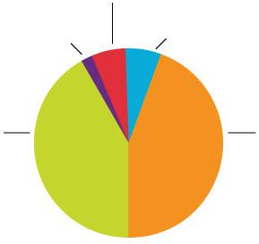
How does the EU spend its money?
2015 EU budget: € 145.3 billion = 1.02 % of gross national income
Global Europe:
including development aid
6 %
Security and citizenship, justice
2 %
Other, administration
6 %
Sustainable growth –
natural resources:
agriculture, environment
40 %
Smart and inclusive growth:
jobs, competitiveness,
regional development
46 %

Slide 14
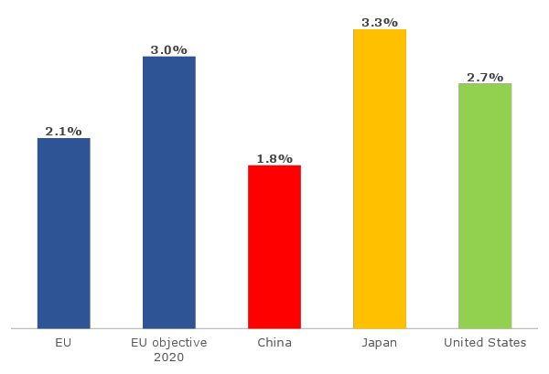

Research - investing in the knowledge society
Spending on research and development in 2012 (% of GDP)

Slide 15
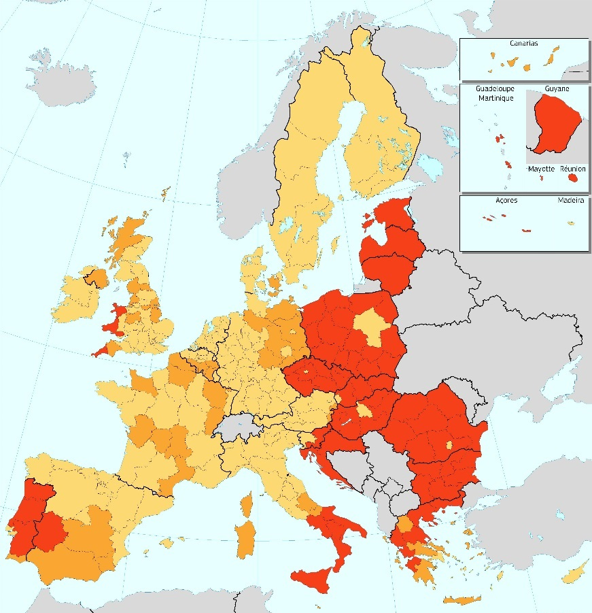



Solidarity in practice: the EU cohesion policy
2014-2020: € 352 billion invested in infrastructure, business, environment and training of workers for the benefit of poorer regions and citizens
Regional fund
Social fund
Cohesion fund
Less-developed regions: GDP per capita under 75 % of the EU average
Transition regions: GDP per capita between 75 % and 90 % of the EU average
More-developed regions: GDP per capita over 90 % of the EU average
Notes:
‹#›

Slide 16
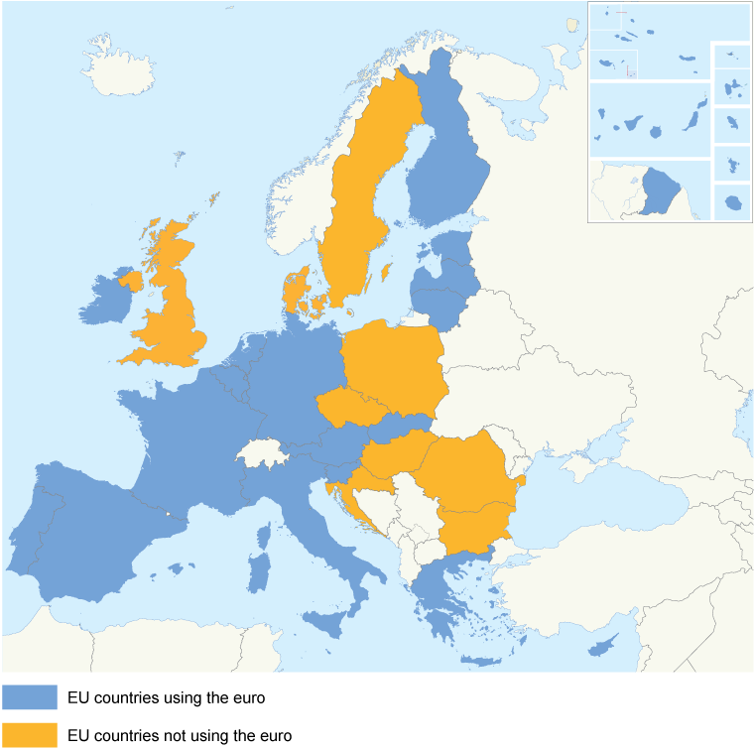
The euro – a single currency for Europeans
Why the euro?
No fluctuation risk and foreign exchange cost
More choice and stable prices for consumers
Closer economic cooperation between EU countries
Can be used everywhere in the euro area
Coins: one side with national symbols, one side common
Notes: no national side
EU countries using the euro
EU countries not using the euro

Slide 17
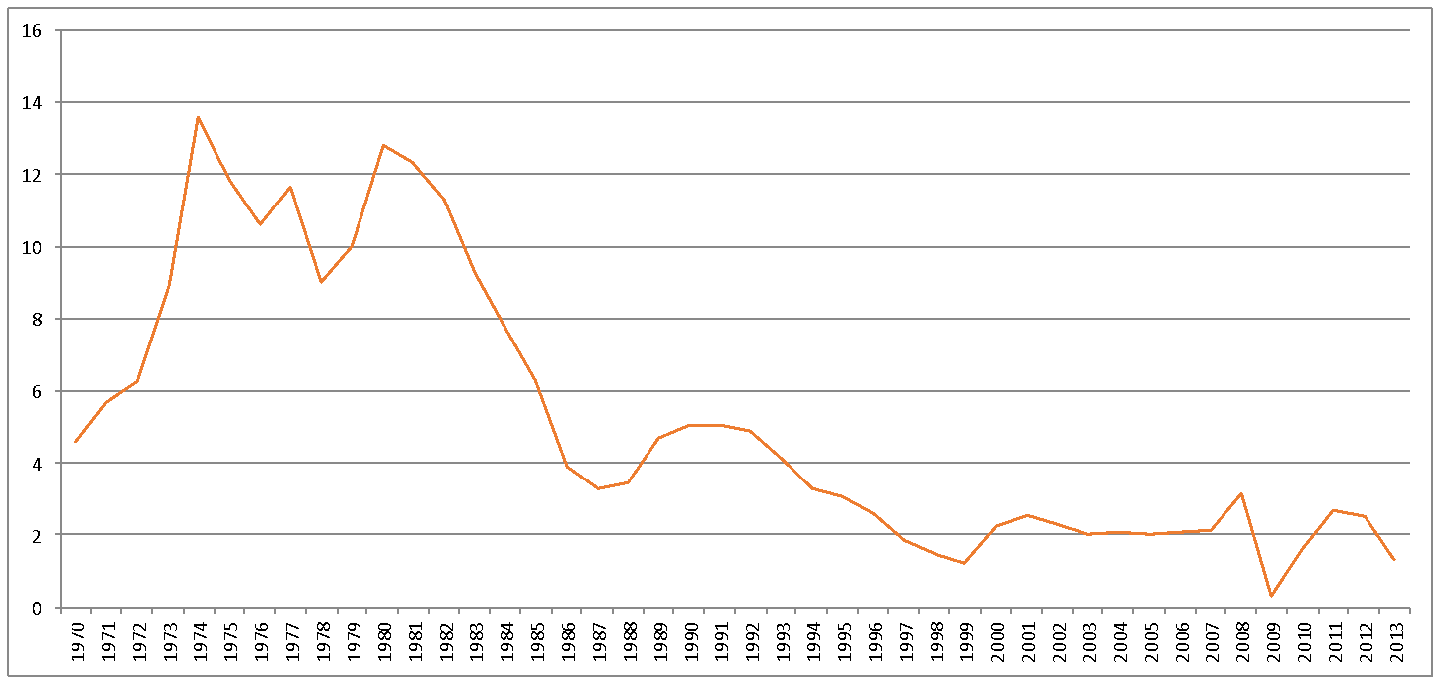
Beating inflation
European Economic and Monetary Union: stable prices
Average annual inflation in the 18 EU countries using the euro (2013)

Slide 18
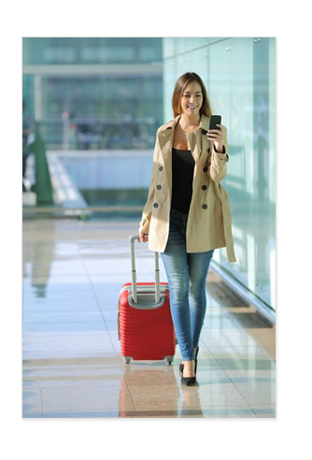
The single market: freedom of choice
Four freedoms of movement:
goods
services
people
capital
The single market has led to:
significant reductions in the price of many products and services, including airfares and phone calls
more choice for consumers
2.8 million new jobs

Slide 19
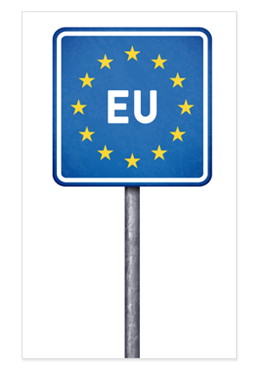
Free to move
‘Schengen’
No police or customs checks at borders between most EU countries
Controls strengthened at the EU’s external borders
More cooperation between police from different EU countries
Buy and bring back any goods for personal use when you travel between EU countries

Slide 20

Going abroad to learn
Erasmus+
Every year, more than 400 000 young people study or pursue personal development in other European countries with the support of the EU’s Erasmus+ programme for education, training, youth and sport.

Slide 21

Improving health and the environment
Pollution knows no borders – joint action needed
EU action has helped bring about:
cleaner bathing water
much less acid rain
lead-free petrol
free and safe disposal of old electronic equipment
strict rules on food safety from farm to fork
more organic and quality farming
more effective health warnings on cigarettes
registration and control of all chemicals (REACH)

Slide 22
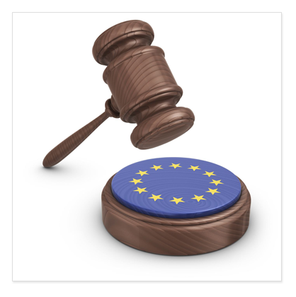
An area of freedom, security and justice
EU Charter of Fundamental Rights
Joint fight against terrorism
Cooperation between police and law-enforcers in different EU countries
Coordinated asylum and immigration policies
Civil law cooperation

Slide 23
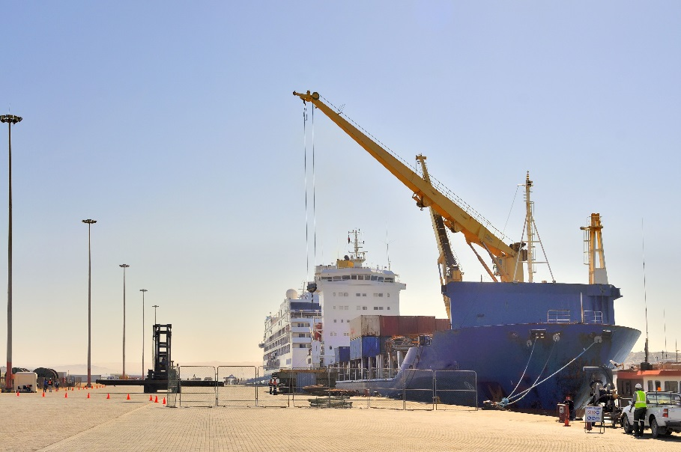
The EU: an exporter of peace and prosperity
World trade rules
Common foreign and security policy
Development assistance and humanitarian aid

Slide 24
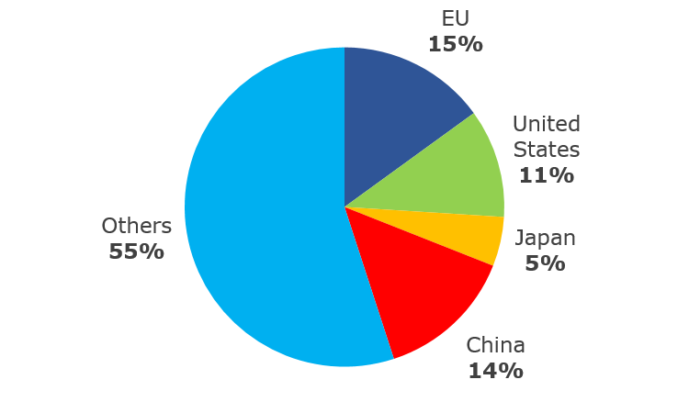
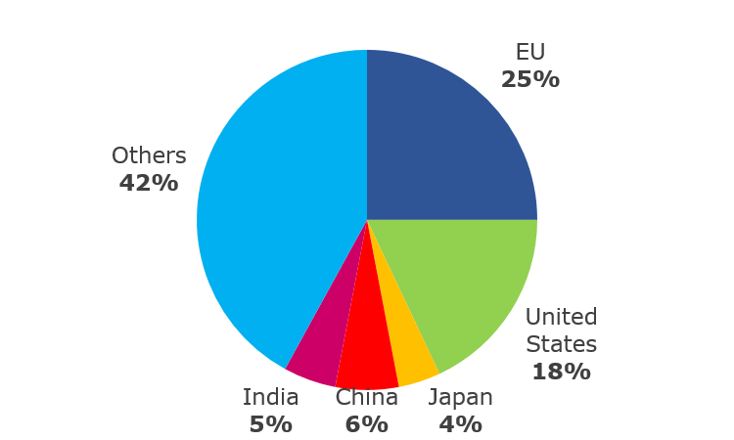
The EU – a major trading power
% of global exports
goods
(2012)
% of global exports
services
(2012)

Slide 25
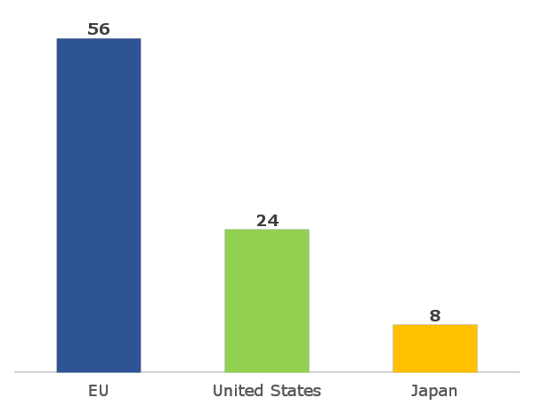
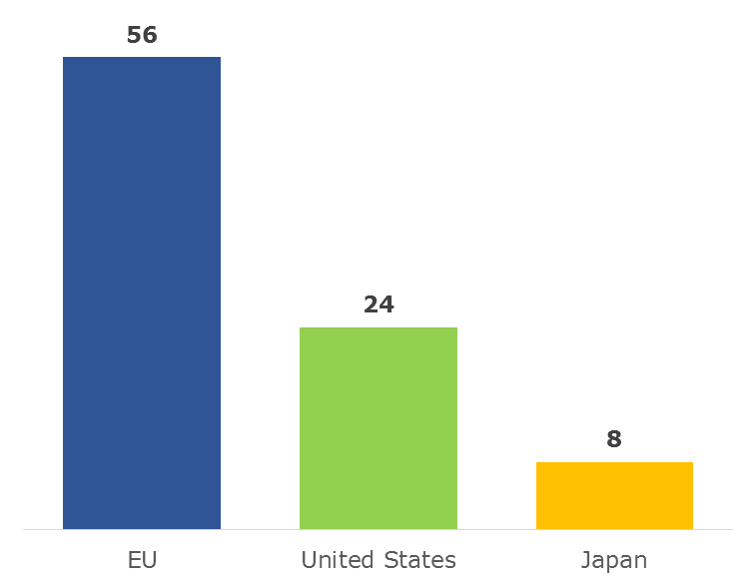
The EU is the biggest provider of development aid in the world
The EU provides over half of all development aid
Official development aid, billion € (2013)
Notes:
‹#›

Slide 26
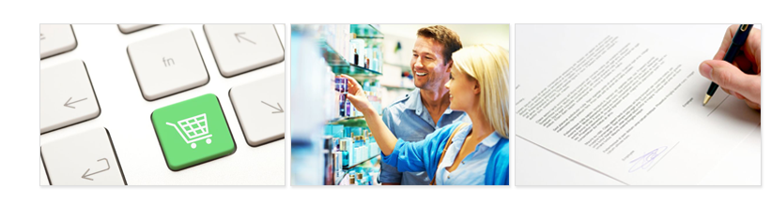
Protecting consumers' rights
As a consumer you are protected by basic laws all over the EU, even when you travel or shop online
Clear labelling
Health and safety standards
Unfair practice in contracts prohibited
Passengers’ rights, such as compensation for long delays
Help to resolve problems

Slide 27
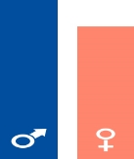
Gender equality
The gender pay gap:
Women in the EU earn on average 16.4 % less per hour than men.

Slide 28
The EU institutions
European Council (summit)
European Parliament
Council of Ministers
(The Council)
European Commission
Court of Justice
Court of Auditors
Economic and Social Committee
Committee of the Regions
European Investment Bank
Agencies
European Central Bank

Slide 29
How EU laws are made
Citizens, interest groups, experts: discuss, consult
Commission: makes formal proposal
Parliament and Council of Ministers: decide jointly
National or local authorities: implement
Commission and Court of Justice: monitor implementation

Slide 30
The European Parliament – voice of the people
Decides EU laws and budget together with the Council of Ministers
Democratic supervision of all the EU’s work
Number of members elected in each country
Austria - 18
Belgium - 21
Bulgaria - 17
Croatia - 11
Cyprus - 6
Czech Republic - 21
Denmark - 13
Estonia - 6
Finland - 13
France - 74
Germany - 96
Greece - 21
Hungary - 21
Ireland - 11
Italy - 73
Latvia - 8
Lithuania - 11
Luxembourg - 6
Malta - 6
Netherlands - 26
Poland - 51
Portugal - 21
Romania - 32
Slovakia - 13
Slovenia - 8
Spain - 54
Sweden - 20
United Kingdom - 73
Total - 751

Slide 31
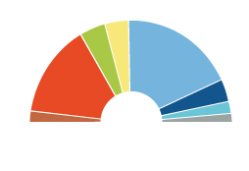
The European political parties
Number of seats in the European Parliament per political group (November 2014)
Alliance of Liberals and
Democrats for Europe
67
European People’s Party (Christian Democrats)
221
Greens/European Free Alliance
50
Progressive Alliance of Socialists and Democrats
191
European Conservatives and Reformists
70
Europe of Freedom and Direct Democracy
48
European United
Left - Nordic Green Left
52
Non-attached members
52
Total: 751

Slide 32
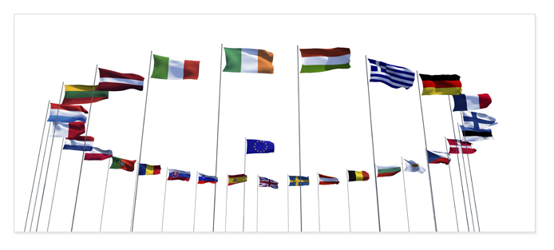
Council of Ministers – voice of the Member States
One minister from each EU country
Presidency: rotates every six months
Decides EU laws and budget together with Parliament
Manages the common foreign and security policy
Notes:
‹#›

Slide 33
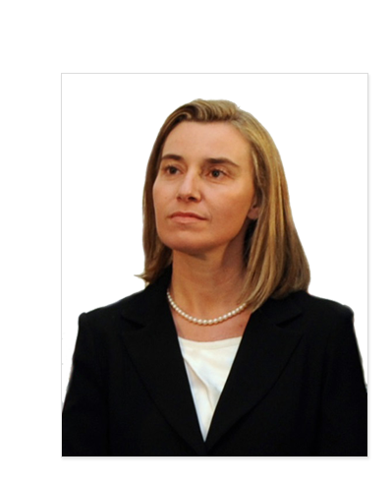
A high representative for foreign affairs and security
Federica Mogherini
Double role:
chairs meetings of the Foreign Affairs Council
Vice-President of the European Commission
Manages the common foreign affairs and security policy
Head of the European External Action Service
Notes:
‹#›

Slide 34
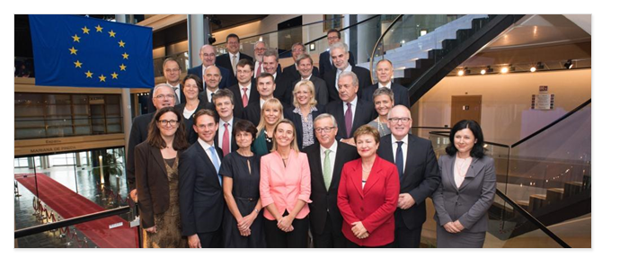
The European Commission – promoting the common interest
28 independent members, one from each EU country
Proposes new legislation
Executive organ
Guardian of the treaties
Represents the EU on the international stage
Notes:
‹#›

Slide 35
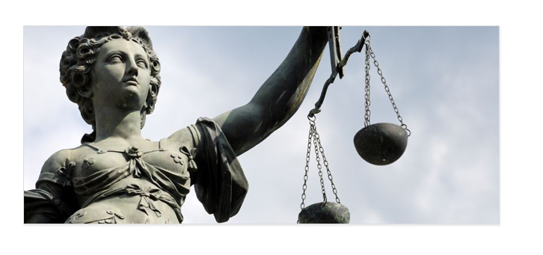
The Court of Justice – upholding the law
28 independent judges, one from each EU country
Rules on how to interpret EU law
Ensures EU countries apply EU laws in the same way
Notes:
‹#›

Slide 36
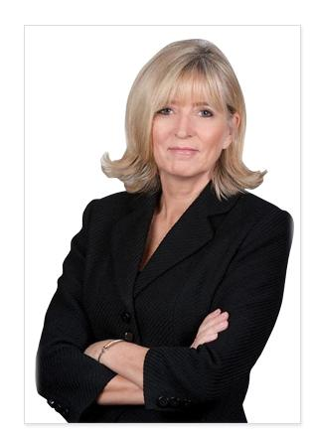
The European Ombudsman
Emily O’Reilly
The European Ombudsman
Investigates complaints about poor or failed administration by the EU institutions
For example: unfairness, discrimination, abuse of power, unnecessary delay, failure to reply or incorrect procedures
Anyone in the EU can make a complaint
Notes:
‹#›

Slide 37
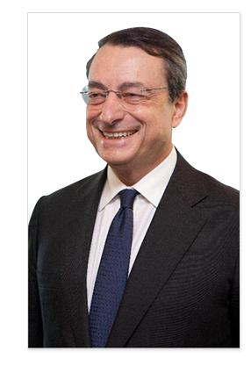
The European Central Bank: managing the euro
Mario Draghi President of the Central Bank
Ensures price stability
Controls money supply and decides interest rates
Supervises that banks are safe
Works independently from governments

